Slide 1
How TEST4U works
TEST4U is an interactive test that automatically assesses candidate’s answer to a question.

Slide 2
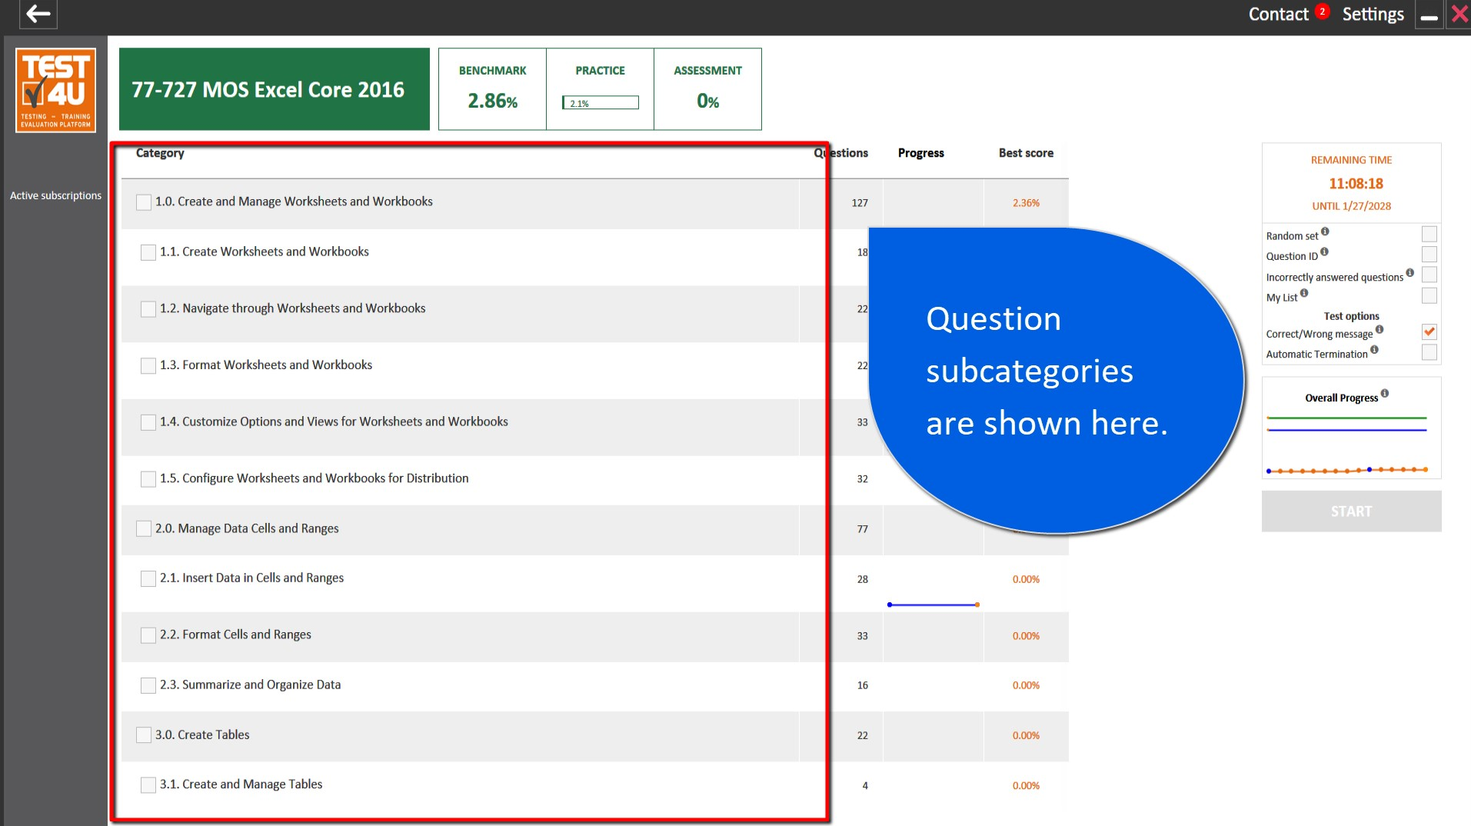
Distinct Subcategories
Questions appear in distinct subcategories
for targeted training.
Each category displays:
  The Number of questions
  A Sparkline graph of your progress
  Your Best Performance

Slide 3
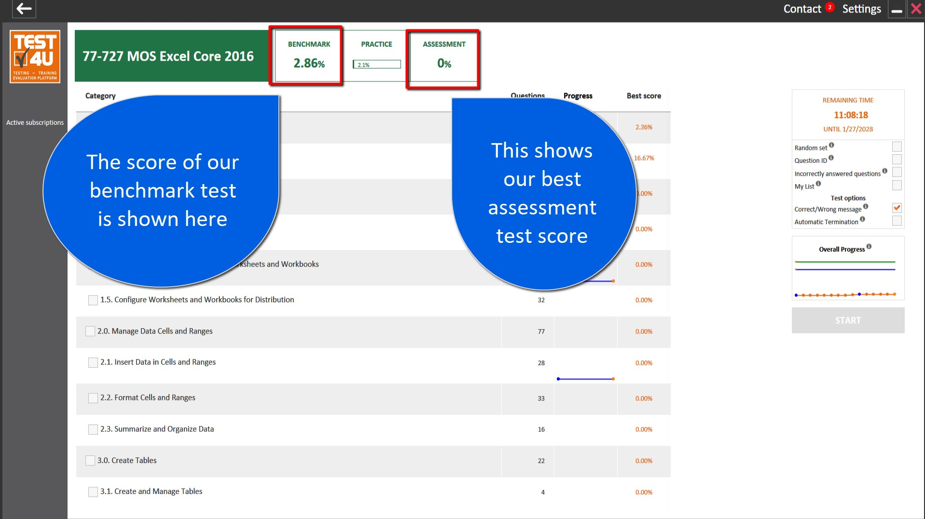
Benchmark and Assessment tests
The first time you open your course a benchmark test will begin to give you an idea of your initial level. The time spent in the benchmark test doesn’t count in your subscription time.
After you have completed your training you can run 2 assessment tests (with new questions). These tests have a time limit just like the exams.

Slide 4
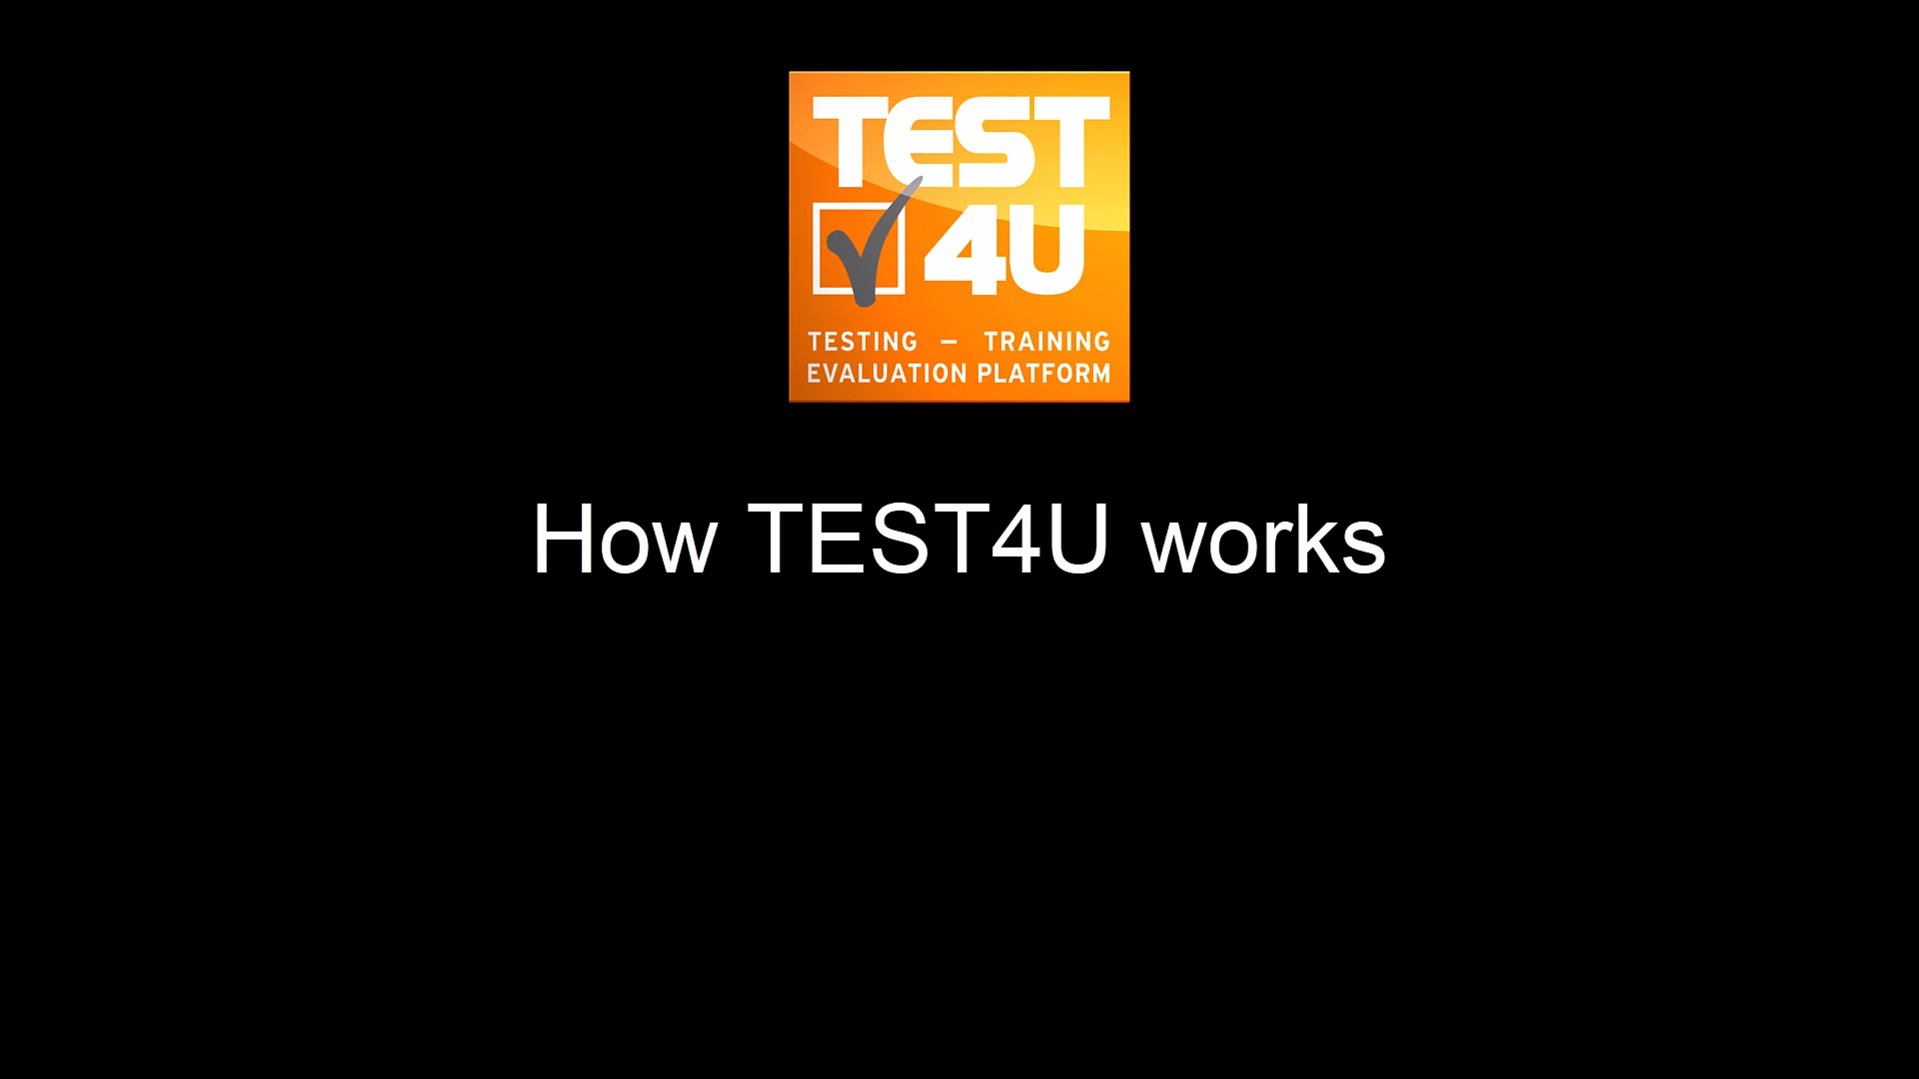
Uses real applications
TEST4U implementation is based on
real application software.
TEST4U is not a simulation application.
So, training on Microsoft Office 2019 requires
Microsoft Office 2019 installed
on the computer.

Slide 5
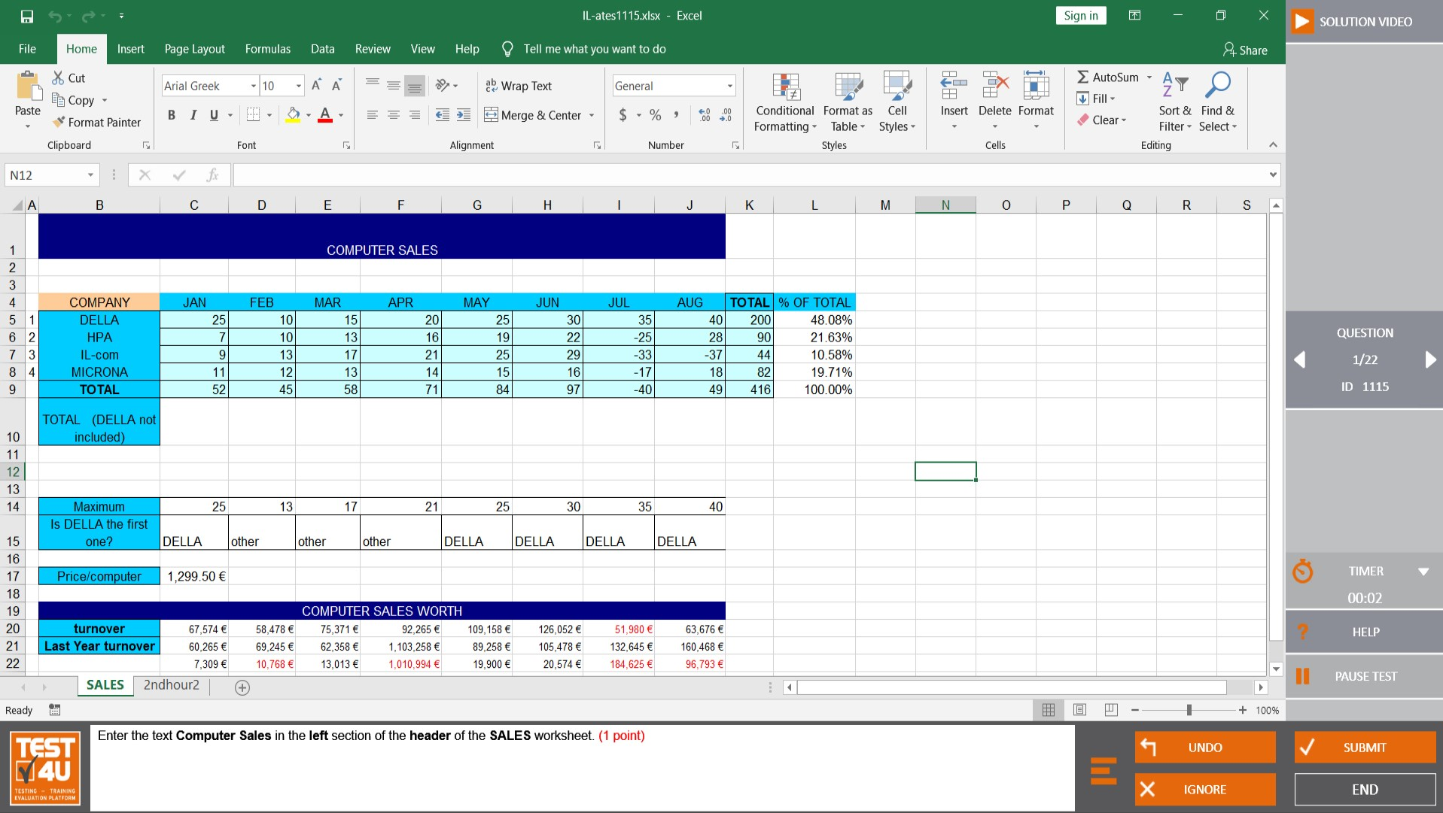
Uses real applications
Full functionality of Microsoft Office suite
for proper training.
Allows the candidate to choose the way
to answer
  TEST4U assesses the result, not the steps

Slide 6
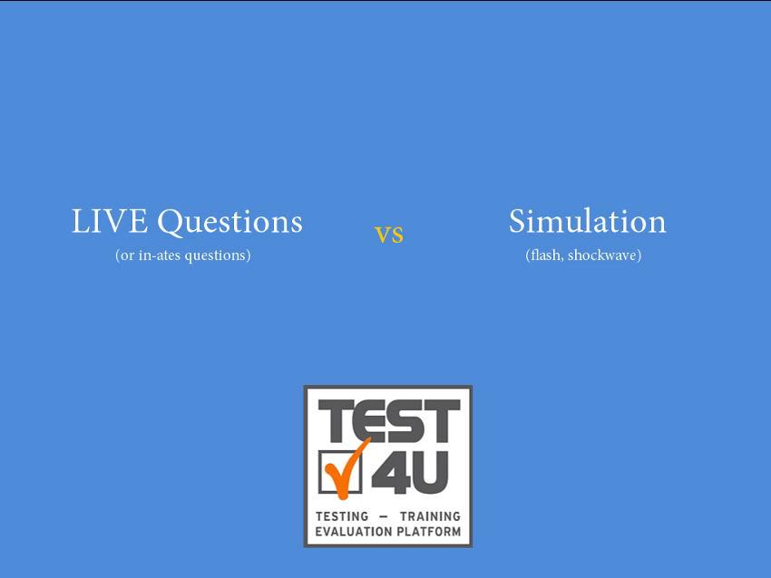
TEST4U assesses the result, not the way of answering questions!
TEST4U means:
  Cooperating with real applications
  Training on Live questions
  Assessment of the result,
  Regardless of the way of answering

Slide 7
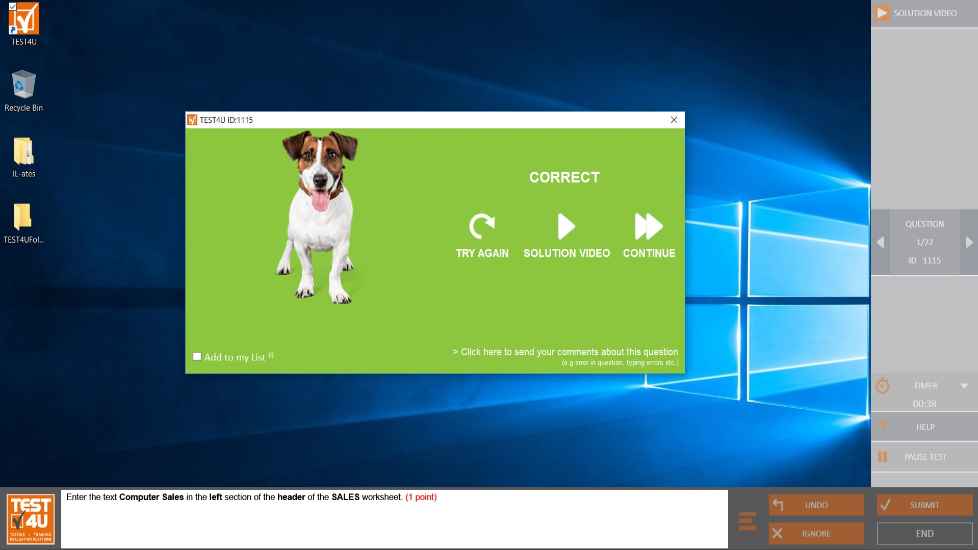
A solution video for every question
Correct Answer?
  You have the option to moves on to the next question or watch a brief video-solution
Incorrect Answer?
  You have the option to moves on to the next question or watch a brief video-solution with the steps you should have taken.

Slide 8
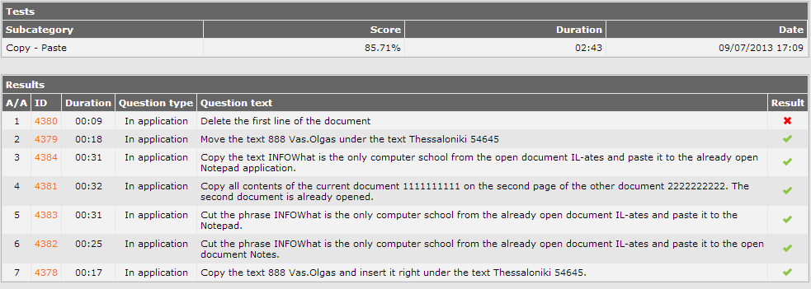
Student statistics
TEST4U provides full range of statistics to check the performance of each student or each class.

Slide 9
more at: www.test4u.eu

