Slide 1
TEST4U Features
The interactive Testing, Training and Evaluation platform

Slide 2
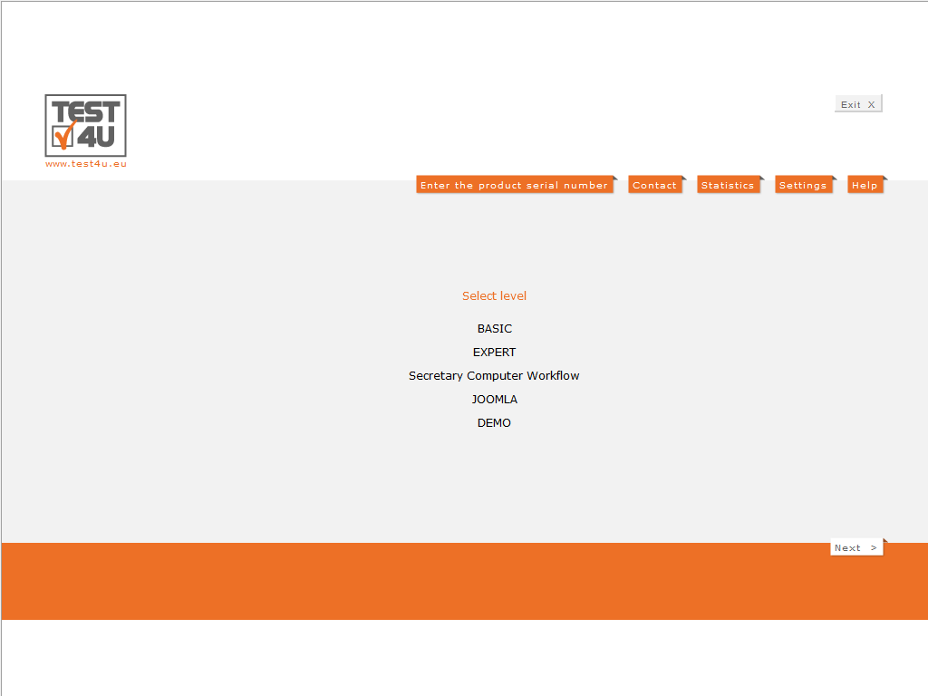
Syllabus Selection
TEST4U covers 100% the syllabi:
MOS 2016
MOS 2013
ICDL / ECDL
For both Core and Expert levels

Slide 3
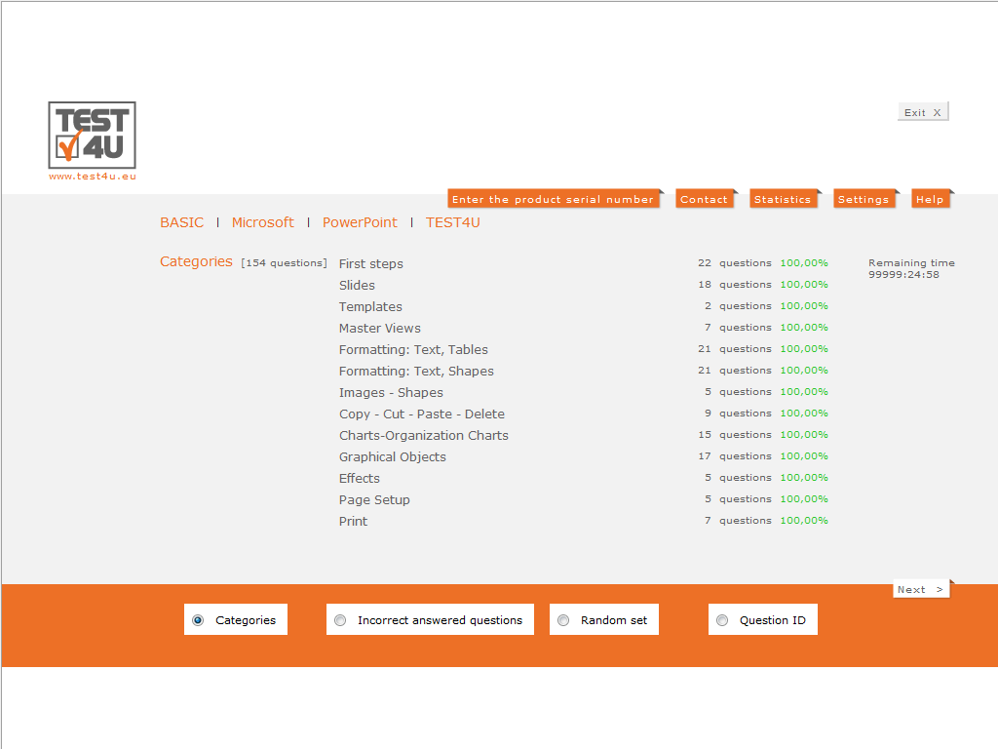
Categories of Questions
Categorized Questions: for targeted practice into distinct categories for better use during the semester and not just before the exams. Wrong Answers: for practicing just at the questions that were answered wrongly. Random Set: creation of a random set of questions for practice. Question ID: Go to a specific question!

Slide 4
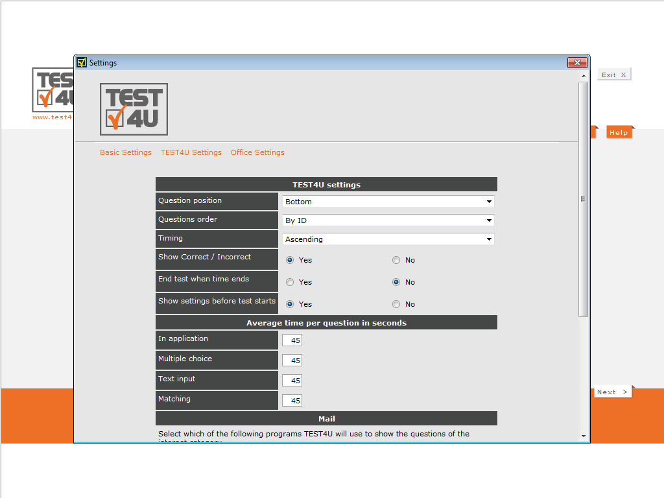
Time Control
Define a time limit for each question to elevate the level of difficulty.

Slide 5
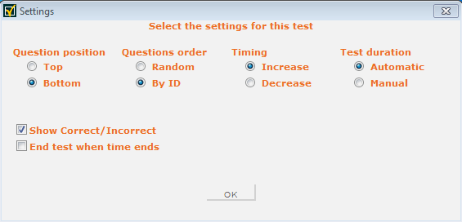
Test settings
More settings
Question in random order.
Display questions in the SAME order (useful during teaching in a group of students)
Simulate Examination process:
Disable the Wrong or Right notification
terminate the test when the time is up.

Slide 6
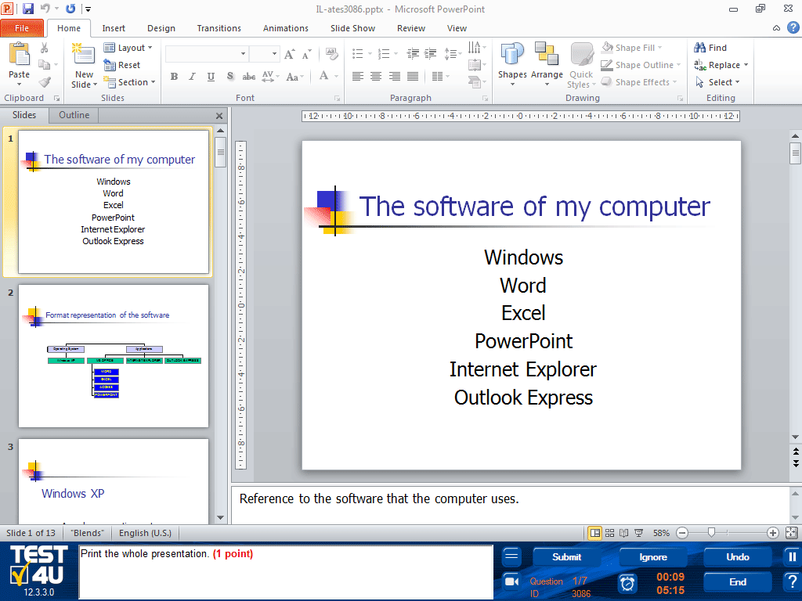
Examination environment
Students become familiar with the Exams.
The TEST4U environment is the same as the Examination environment.

Slide 7
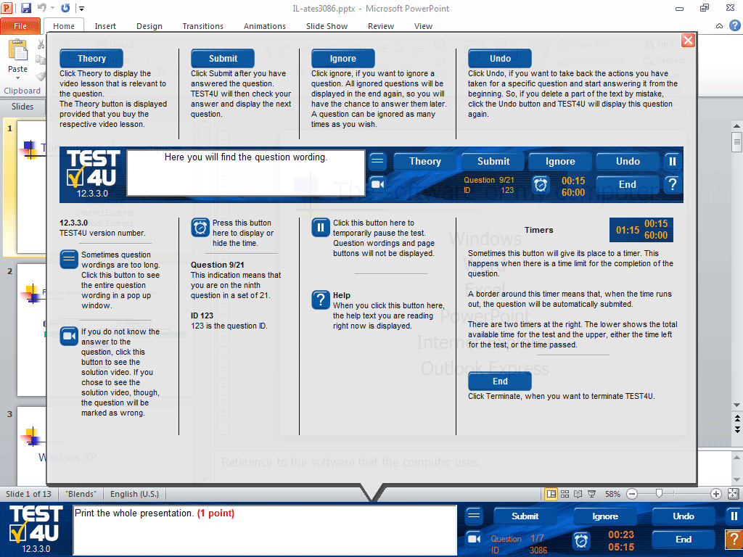
Help
Brief guidance for the functions of the program

Slide 8
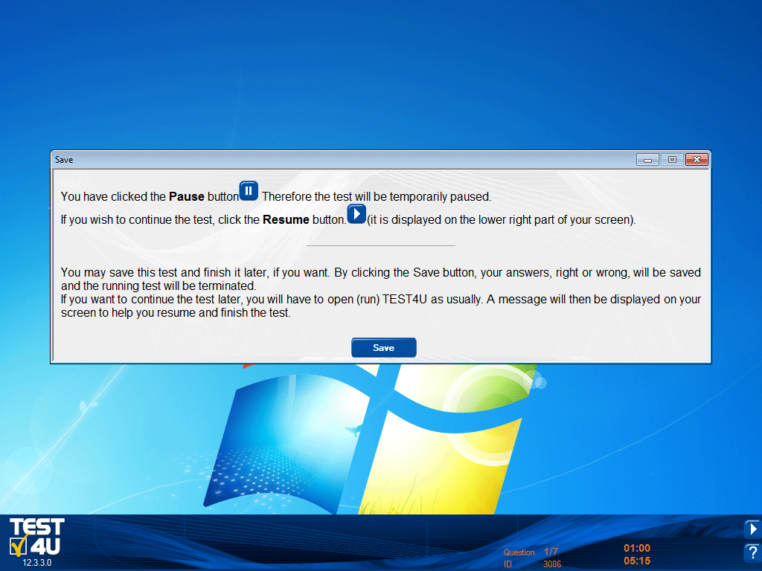
Pause or Save a test
Temporarily stop the test by clicking at:
Option to save the test and terminate the application.
The next time TEST4U runs, the student is asked to continue the saved test.

Slide 9
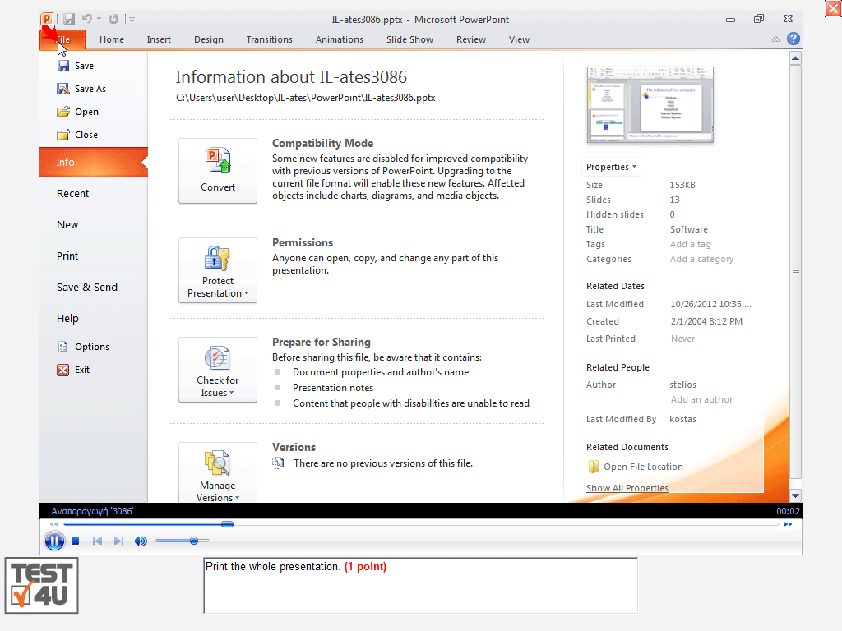
Video-Solutions
TEST4U is much like a dedicated private instructor!
Each question is accompanied by a brief video with the right way to solve it.
Watch the video solution after a wrong answer or while trying to answer for better understanding.

Slide 10
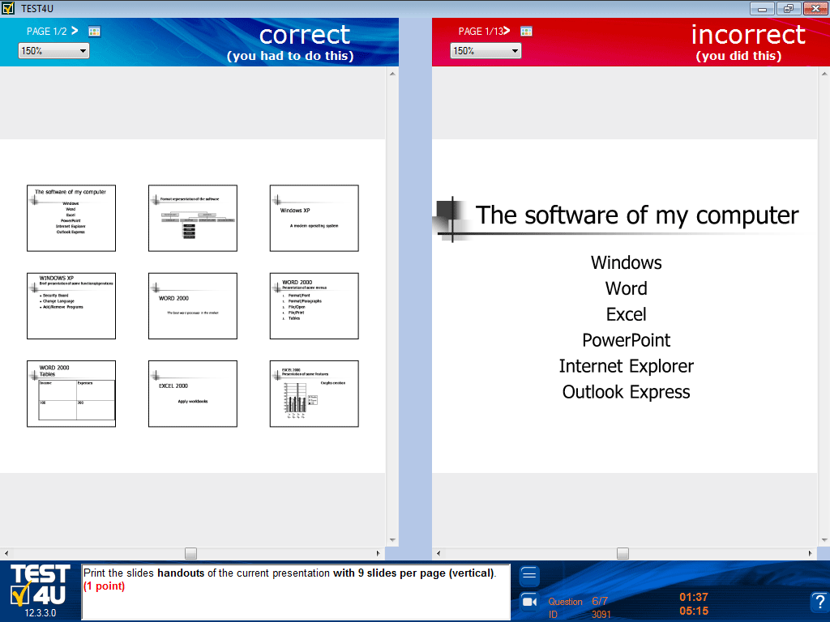
Right vs Wrong answer
DILPOMA level questions
Special category – special technology!
TEST4U displays a comparison of the right and wrong solution for the DIPLOMA level questions.
You know where things got messy!
TEST4U displays the list of mistakes.

Slide 11
Continue the test
TEST4U Recovery Technology
Computer crashes are no longer a headache!
Rely upon the TEST4U technology and continue practicing from the point right before the crash.

Slide 12
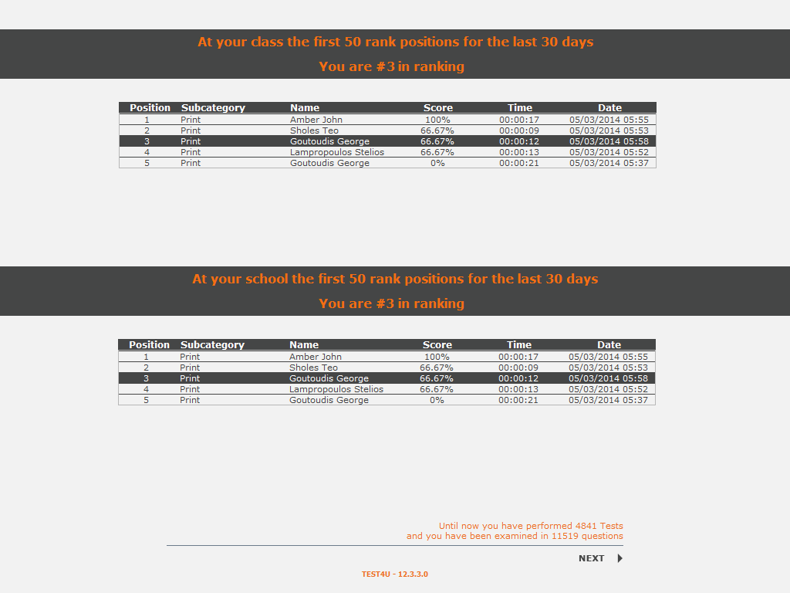
TOP 50
Are you among the top 50 candidates?
TEST4U increases the noble competition among students!
At the end of a test ends, a list with the names of the top 50 students and their best times at this exam is displayed.
The top 50 list is displayed for the students of a class and for the rest of the students in the Educational Institution.

Slide 13
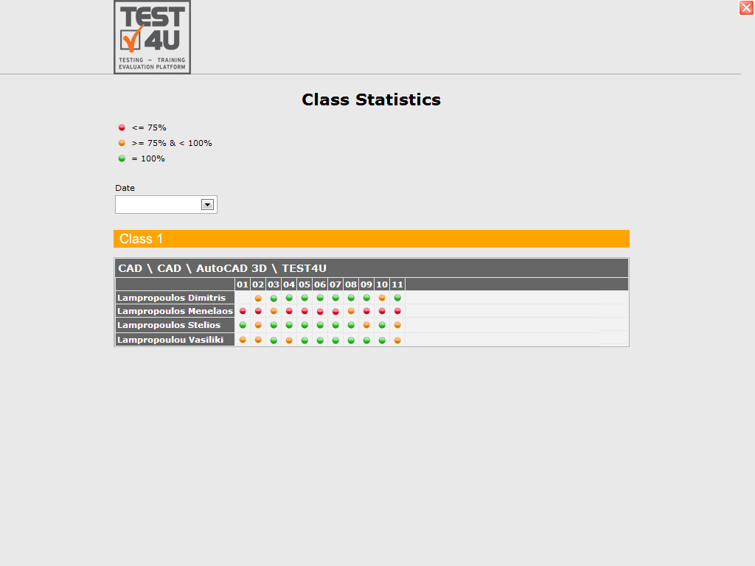
Descriptive Statistics of the class
Descriptive statistics of the class at a glance!
When a test ends, students can see the descriptive statistics of the class. The same statistics are available for the teacher to access through the webpage. This table shows the progress of each student at a glance.
Green dot stands for 100% score achieved many times.
Orange dot stands for over 75% score achieved a few times.
Red dot stands for below 75% every time.
No dot stands for unfinished tests.

Slide 14
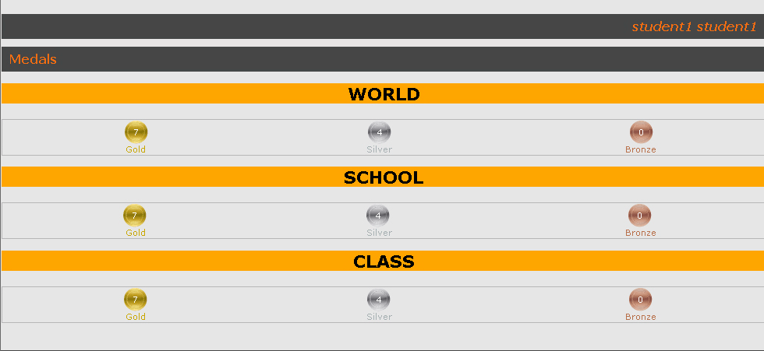
Medals
Browsing the student’s medals
Completion of a task is rewarded with a medal.
Compared to:
the rest of the classmates
the school
all the students worldwide who have completed the same test.

Slide 15
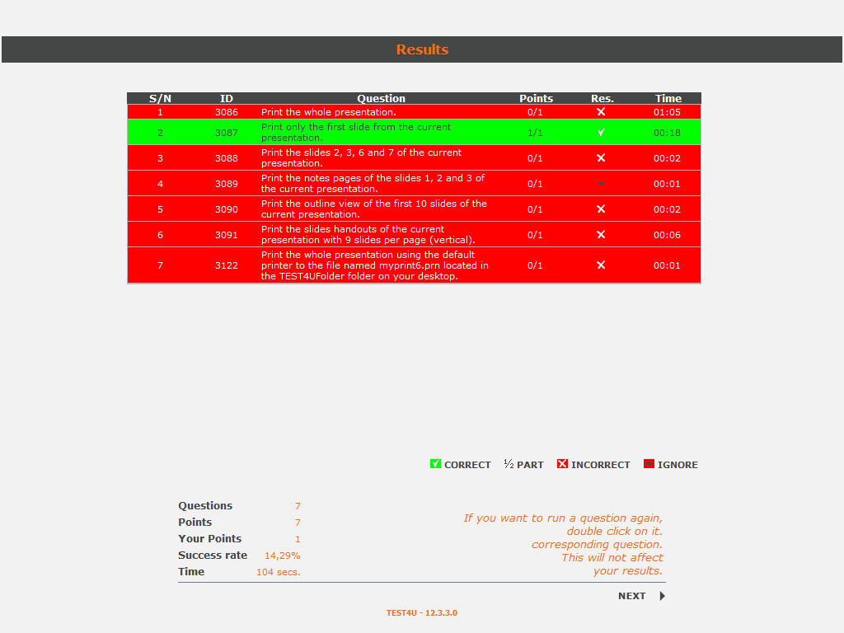
Interactive results
TEST4U Results
Double click on each question to run it again at the results page.
TEST4U allows you to browse the mistakes without having to retake the whole test.

Slide 16
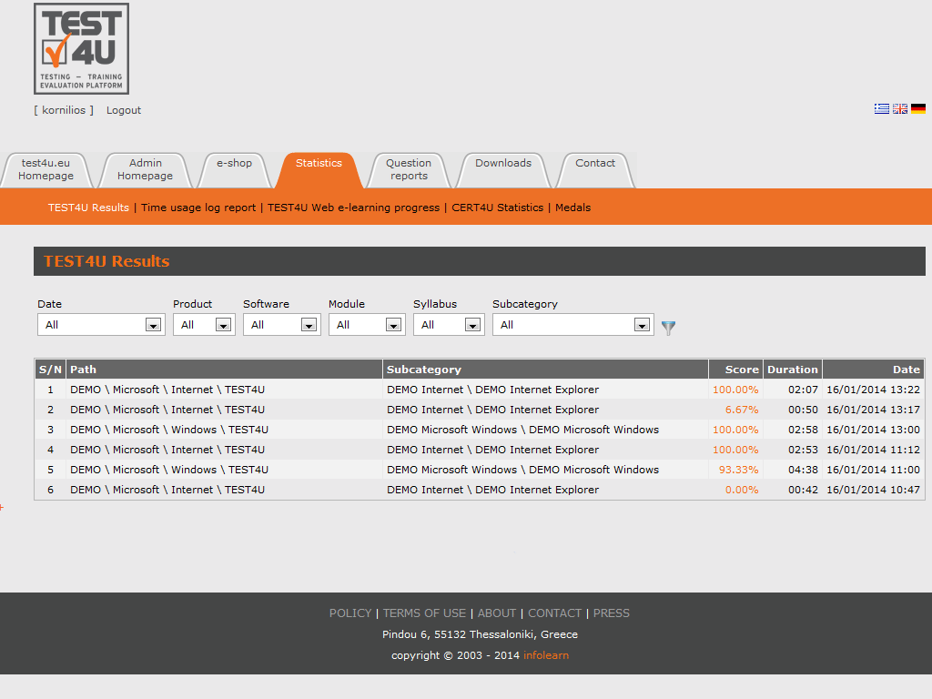
User’s Statistcs
Candidates (students)
log in with their personal accounts
have access to their statistics

Slide 17
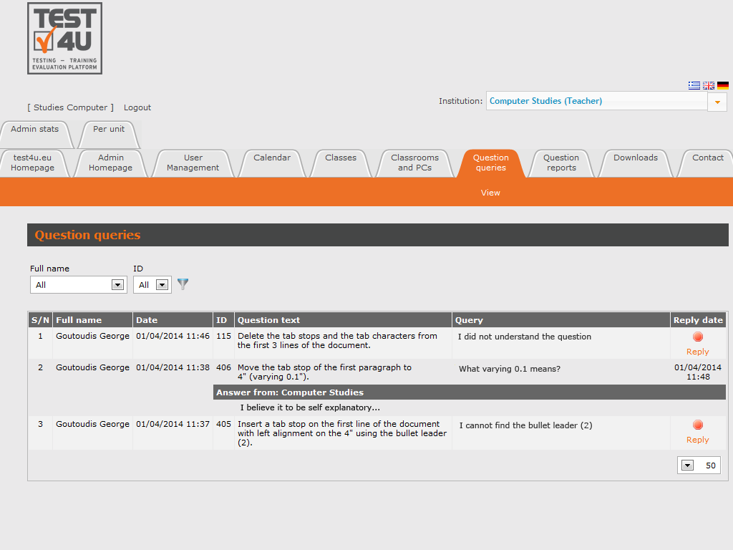
Student’s Questions
The teacher can see and answer the student's inquires, about specific training questions in TEST4U.

Slide 18
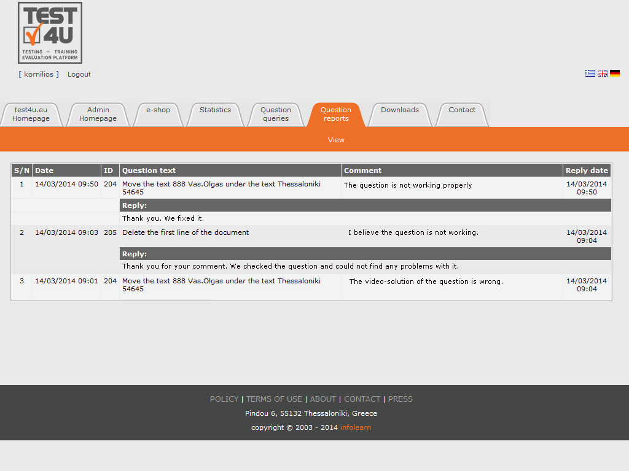
Question Reports
Constant review of Questions by the TEST4U support Team
Each user (student, teacher) can submit a report to the TEST4U support team concerning a problem spotted at a question.

Slide 19
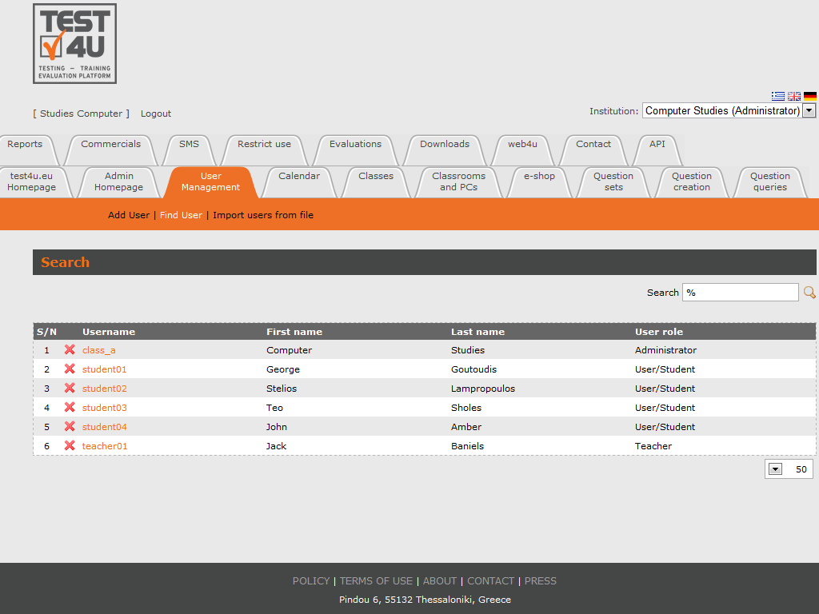
Student’s management
Four types of TEST4U users
There are four types of users at TEST4U:
Students
Teachers
Secretaries
Administrators

Slide 20
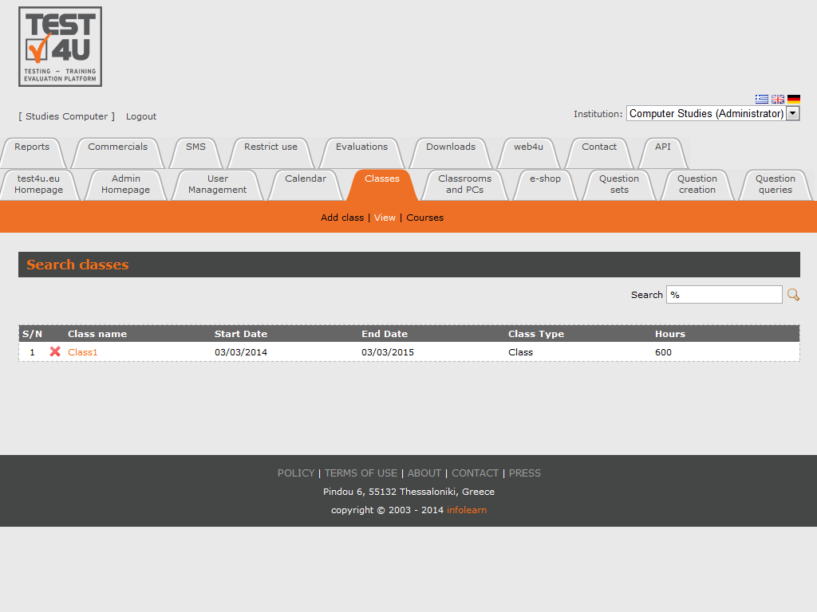
Class management
Add, delete and edit your classes.

Slide 21
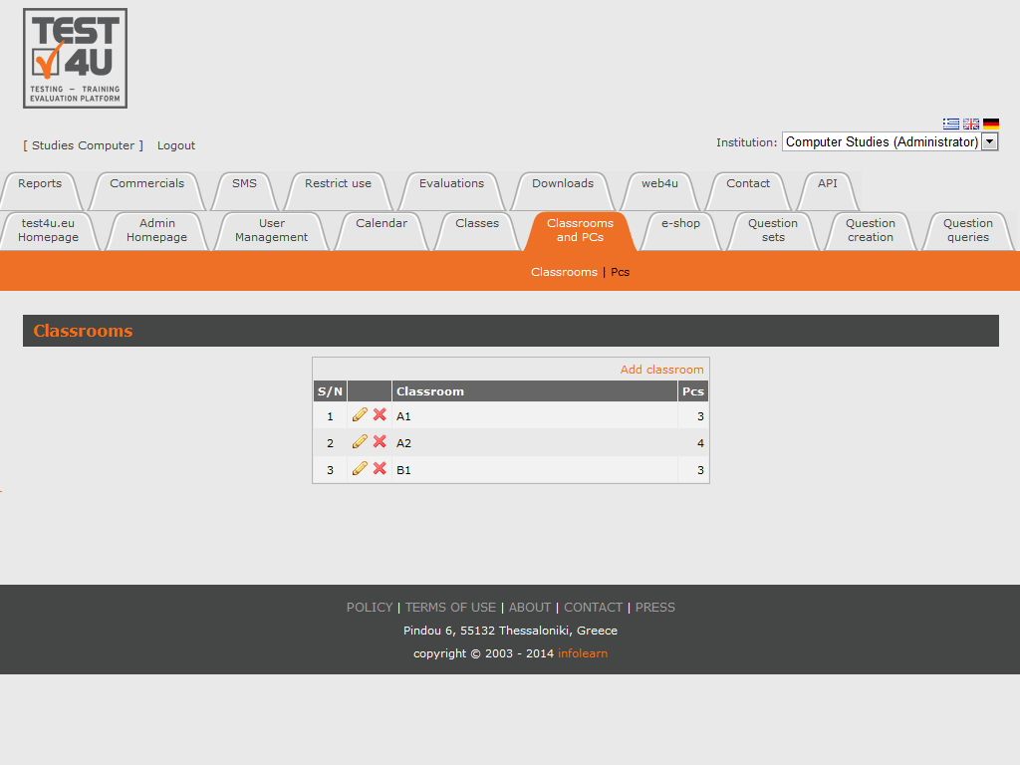
Classroom and Computer management
Add, delete, and edit the computers of each class.

Slide 22
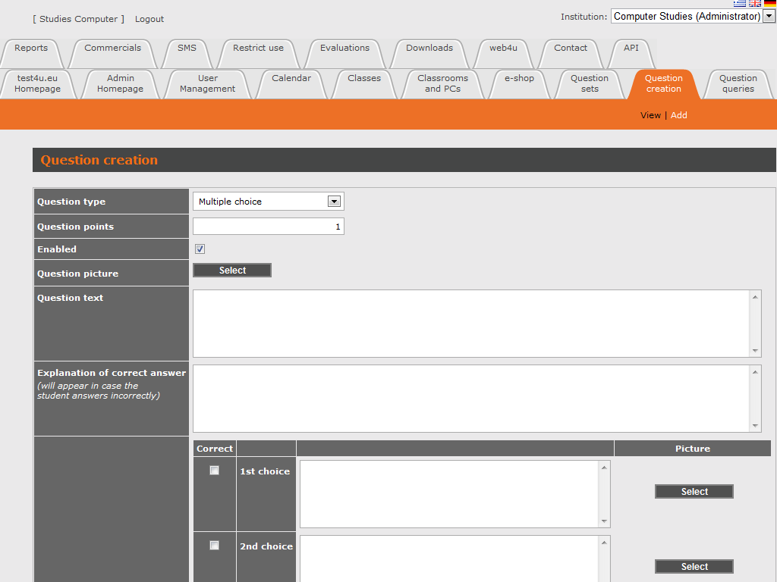
Add Questions
Add your own questions on your own! The module "Question creation“ allows you to enter your own questions.
These questions can be
Multiple choice type
Matching type
Text input type questions.

Slide 23
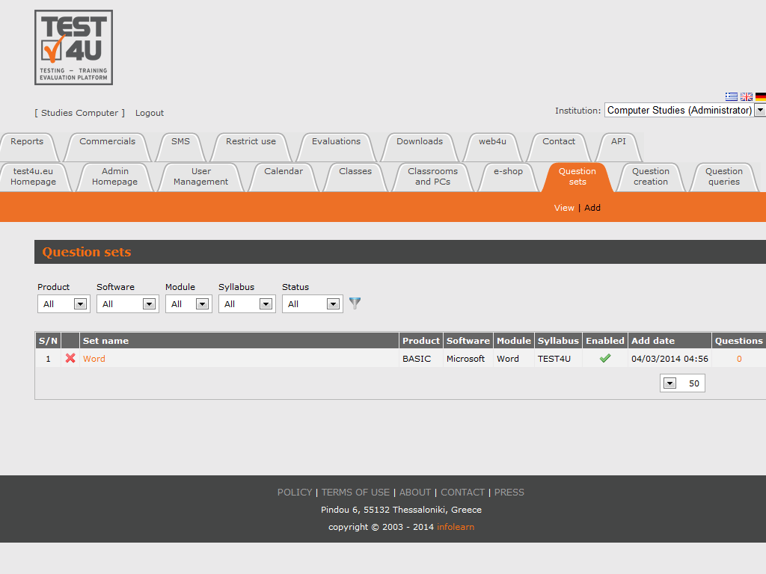
Create your own tests
The module "Question sets“ allows you to create your custom Questions Sets
Select some of the existing questions.
Useful when you need to train our staff or examine your candidates on specific subjects.

Slide 24
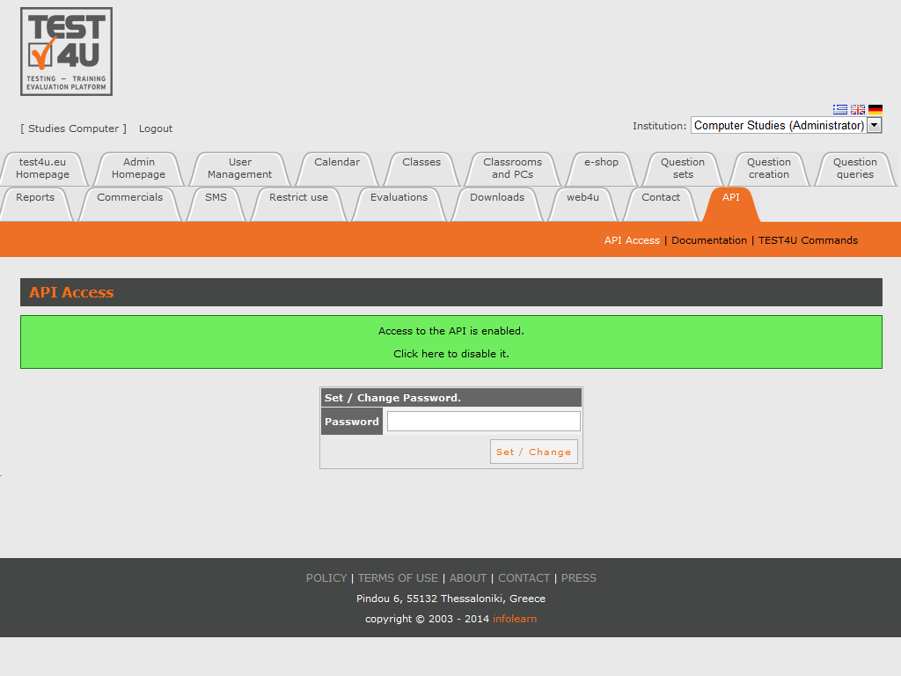
API
Through TEST4U API you can have access to most of test4u.eu data in order to connect your own application with TEST4U platform.

Slide 25
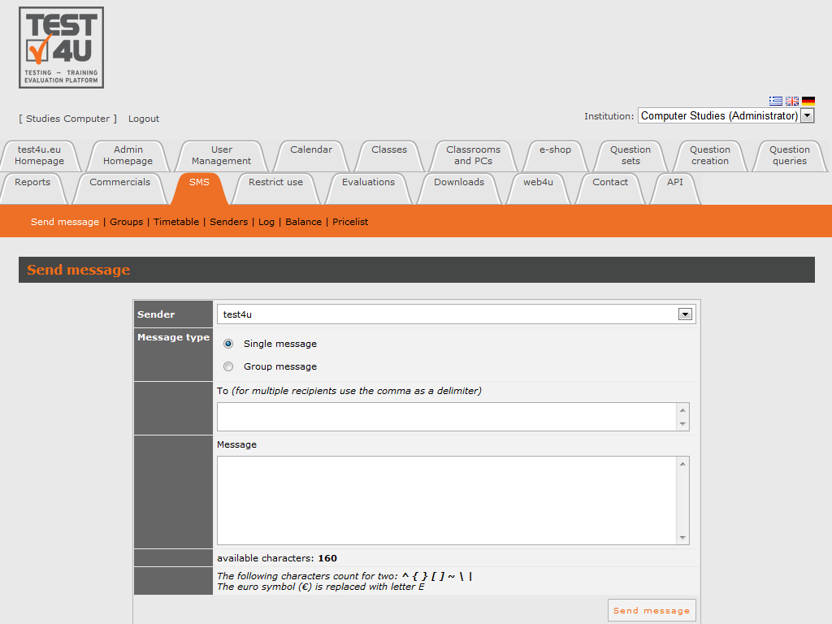
Send SMS
The "SMS" module allows you to send SMA
Create Contact lists
Brief i.e. all the teachers of your school at once.
Set a timetable for SMS sending.
Automatically send SMS to your students on their birthday and on holidays such as Christmas, New Year.
Send SMS to all of your students, or just the ones attending a class at the time being.

Slide 26
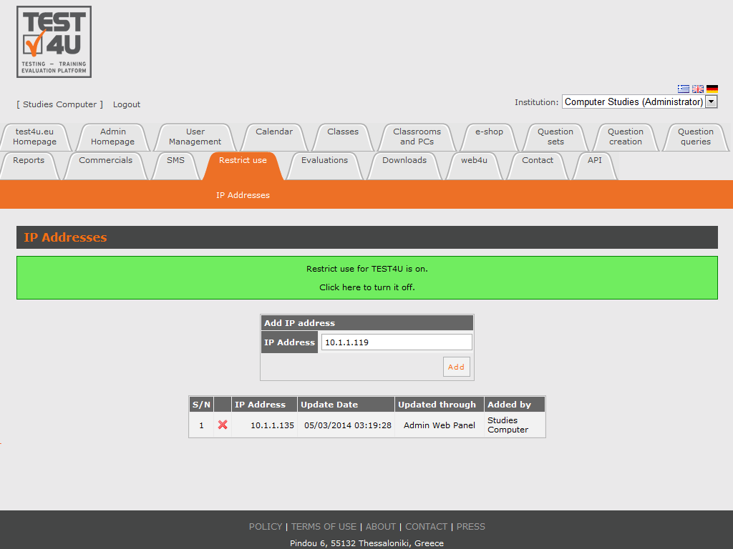
Restriction of Use
The module "Restrict Use“ allows you to restrict the use of TEST4U by your students to specific computers (e.g. your school computers).

Slide 27
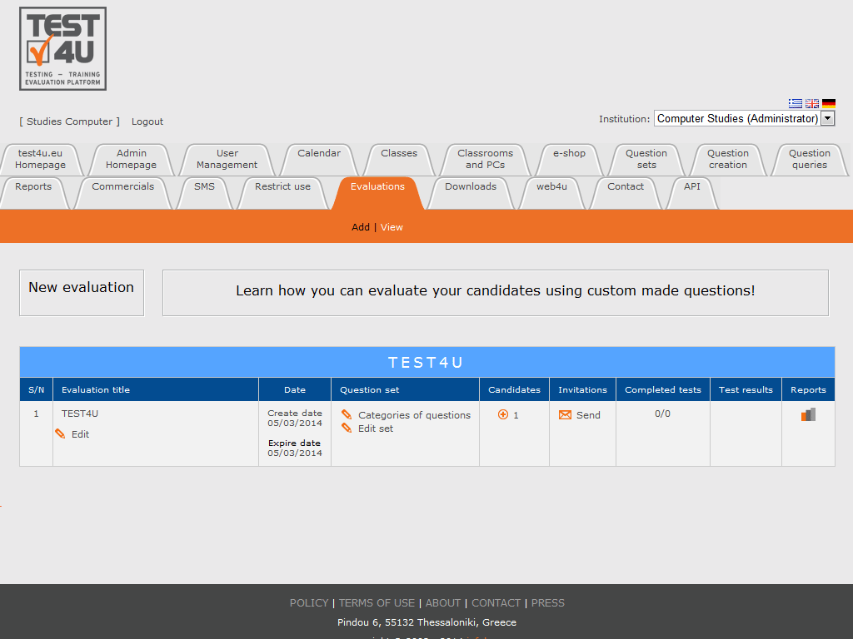
Evaluation
Evaluation is a process which allows you to:
Evaluate candidates
Evaluate existing employees
The module "Evaluation“ enables the evaluation option.
Each candidate receives an e-mail about a test with questions and exercises at the contact details that you have entered. This is how you can evaluate many candidates in a short period of time.
Enter the candidate's contact information and the evaluation platform TEST4U sends you the password for each candidate.

Slide 28
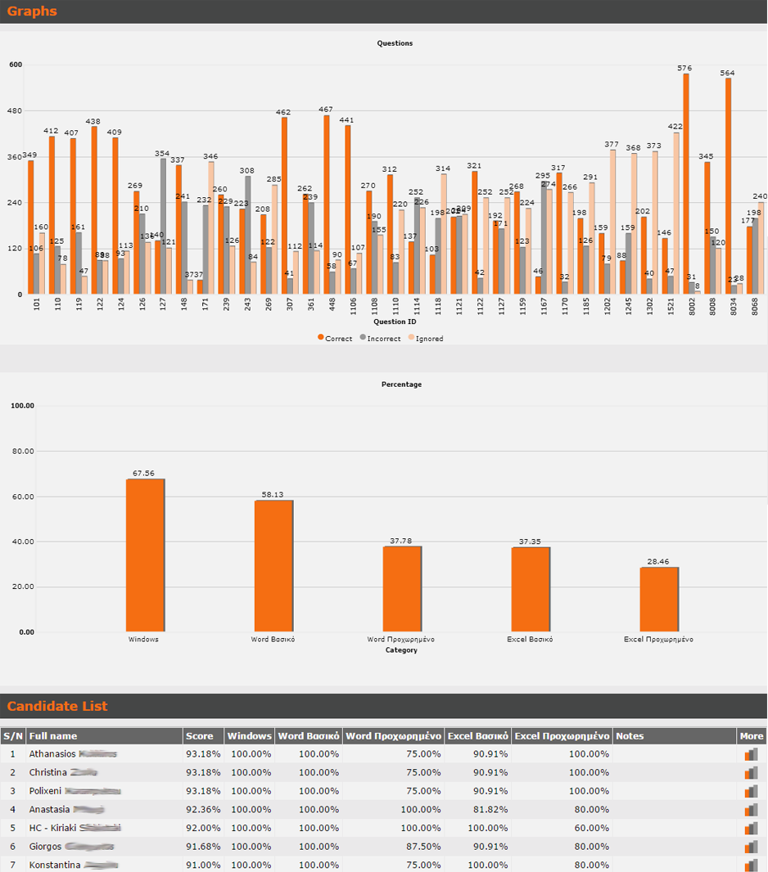
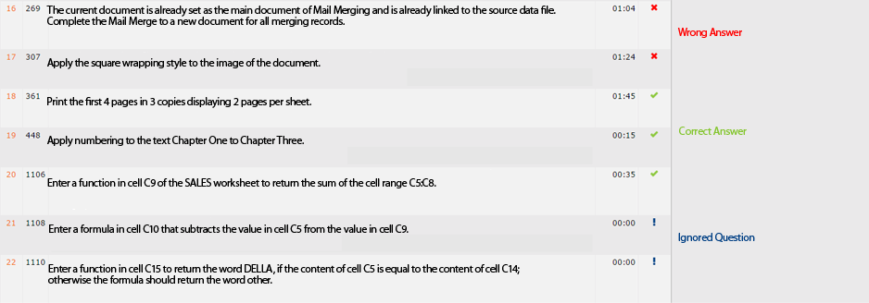
Evaluation

Slide 29
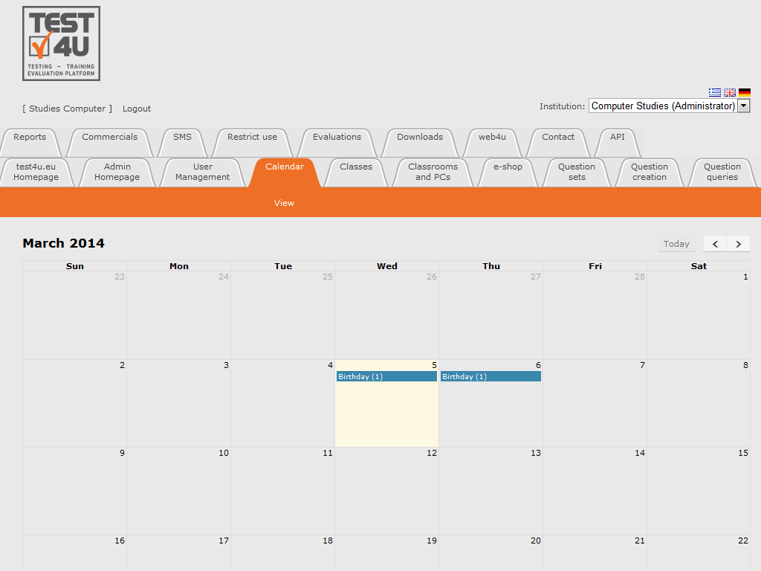
Calendar
Calendar displays the name of the students who have their birthday. You can use this reminder to wish them "Happy Birthday".

Slide 30
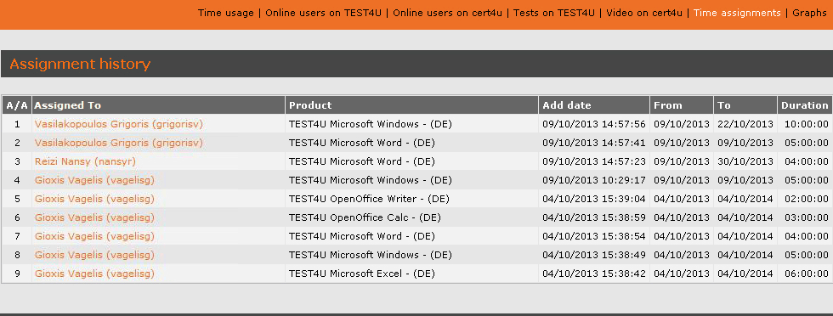
Reports – Graphs
Login to http://www.test4u.eu to access the reports.
Reports provide you with some basic management information of your school.
You can see:
the students who are logged in
the time consumption for each of them and each module
the tests performed at the school
other interesting graphs

Slide 31
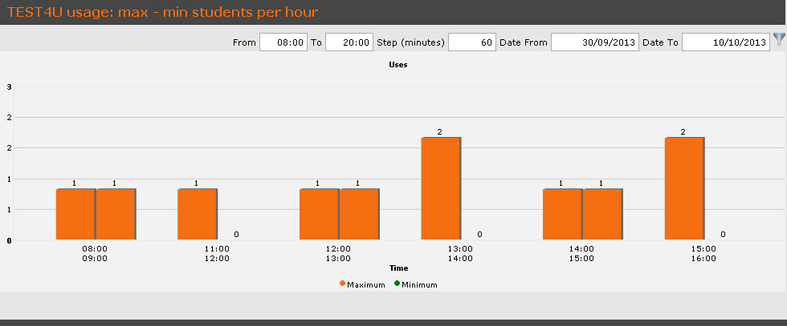
Reports – Graphs

Slide 32
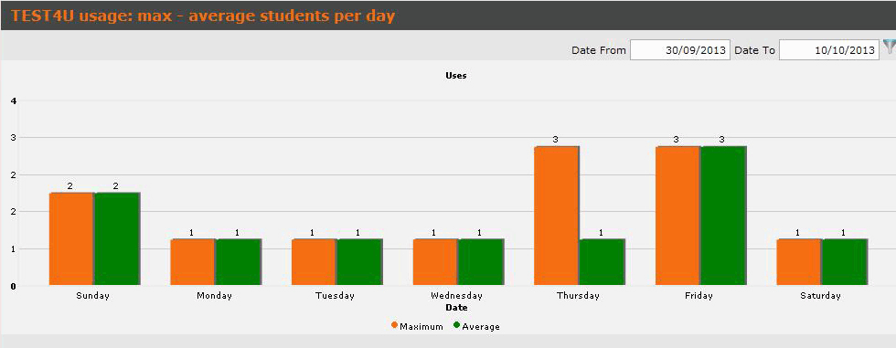
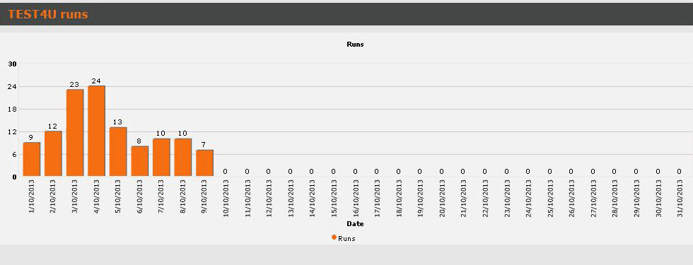
Reports – Graphs

Slide 33
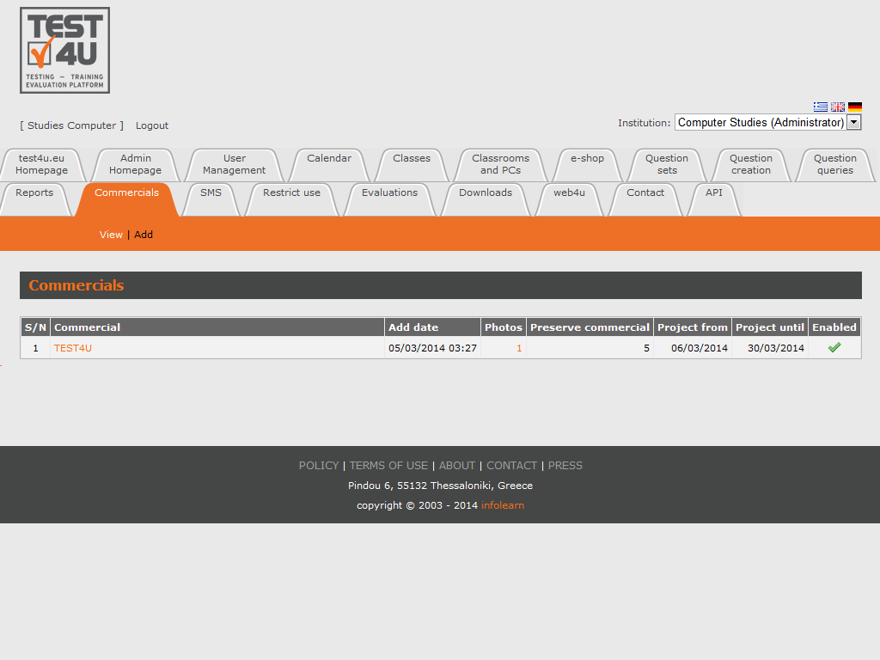
Commercials
TEST4U disposes the module "Commercials" which can be used in order to display advertisements to your students during the test.
It is completely customizable as to how often and which students will see these advertisements.

Slide 34
more at: www.test4u.eu

